Slide 1

Tetris with c++
Gaire Ananta Prasad M24W0272

Slide 2
Topic to be covered
Why I choose Tetris
Introduction about Tetris
Reylib Library
Improvement
Step the build Tetris
Conclusion
Q/A and About Me

Slide 3
Why I choose Tetris for the Final Project
Focus
Break Down a Problem
Problem solving skills
Concentrate on Project
Satisfaction
Improve Coding skills

Slide 4
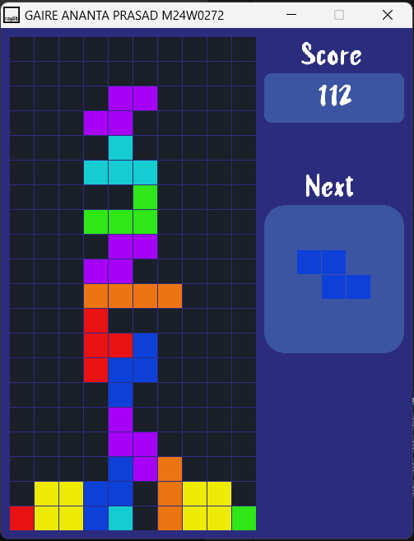
Tetris
Gaire Ananta Prasad
Tetris is primarily composed of a field of play in which pieces of different geometric forms, called "tetrominoes", descend from the top of the field. During this descent, the player can move the pieces laterally and rotate them until they touch the bottom of the field or land on a piece that had been placed before it.
Tetris with c++ is the simple version of the tetris real game. I made this game in C++ with the use of the Raylib library. Simply we can play the game and score.

Slide 5
Raylib Library
raylib is a programming library to enjoy videogames programming; no fancy interface, no visual helpers, no gui tools or editors... just coding in pure spartan-programmers way.
raylib does not provide the typical API documentation or a big set of tutorials. The library is designed to be minimalistic and be learned just from a cheatsheet with all required functionality and a big collection of examples to see how to use that functionality. Best way to learn to code is reading code.

Slide 6
Improvement
User Authentication
Game level

Slide 7
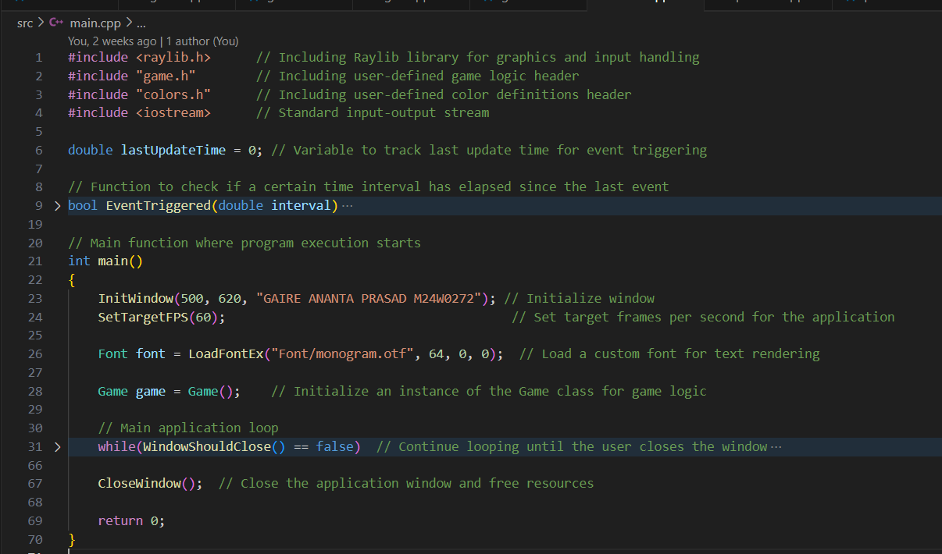
Steps to Build Tetris
Setup to develop Tetris
Create a Game screen and the Game loop.

Slide 8
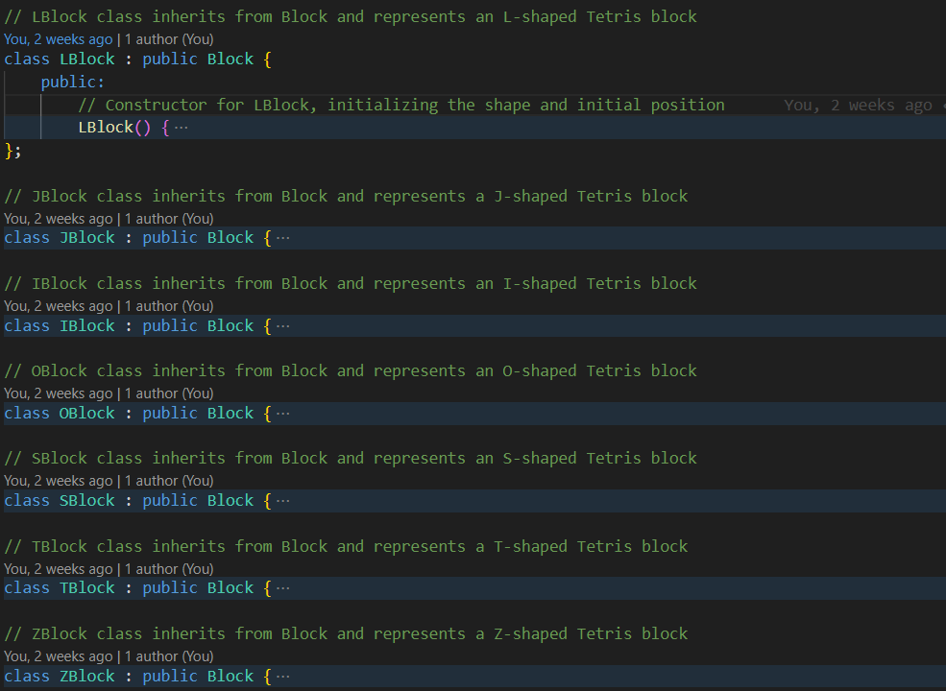
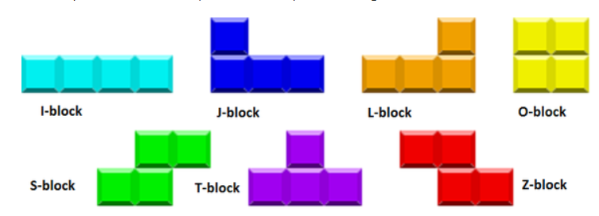
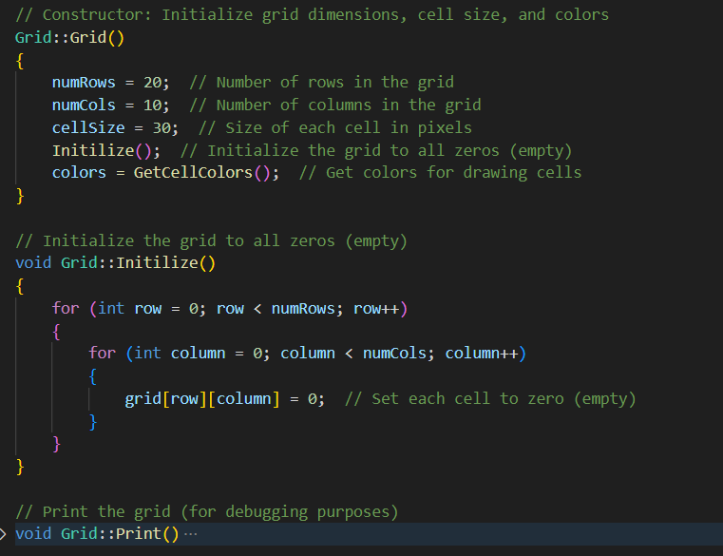
Creating the Grid and Blocks.
In the grid number of rows are 20 and number of columns are 10. the total size of cell are 30.
In the blocks there are 7 Blocks. Lblock, Jblock, Iblock, Oblock, Sblock, Tblock, Zblock.

Slide 9
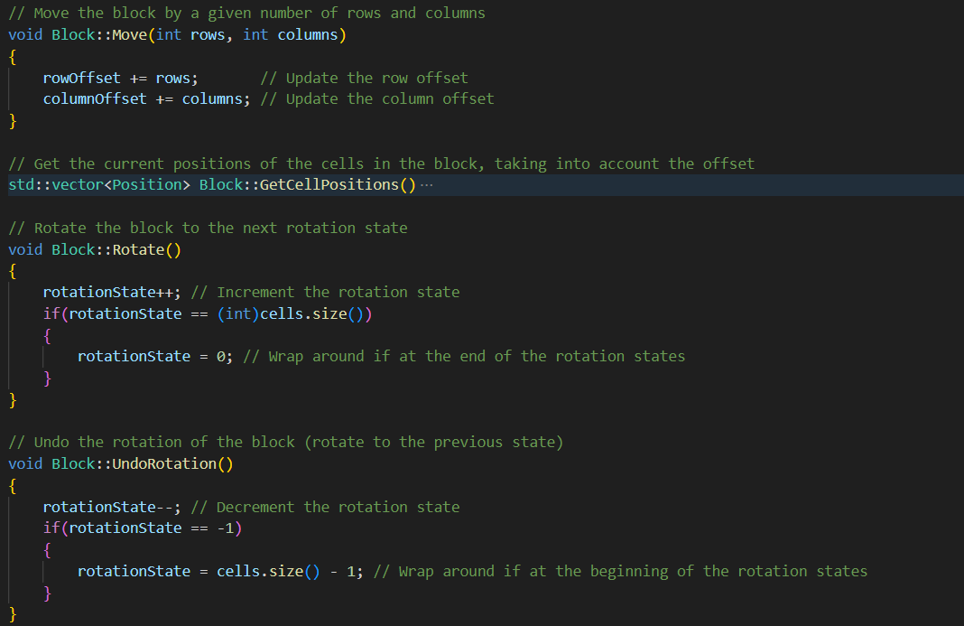
Move and Rotate the block
Player can rotate the blocks accordingly and can rotate also
I am using up-arrow key for rotate the block, side arrows key for move the block left and right and down arrow key for move the block down one step fast and score 1.

Slide 10
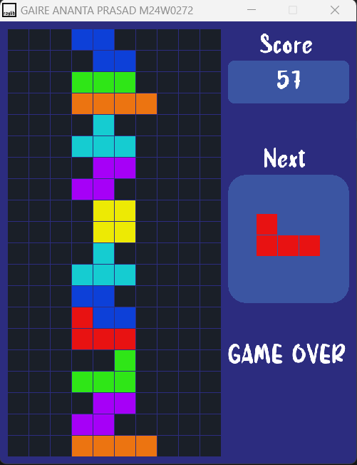
Completed Rows and Game Over.
If the user successfully fill the all the columns, then the rows clear and score updated.
If user does not able to clear the rows and the block are full the game will over

Slide 11
Conclusion
Creating a Tetris game using C++ and the Raylib library has been a rewarding project, showcasing fundamental programming skills and game development principles. This experience has not only deepened my understanding of C++ but also provided practical insights into using libraries for graphical applications.

Slide 12
Q/A
Thank You ☺
Gaire Ananta Prasad
KCGI, Data Science, 1st sem. www.anantgaire.com.np
www.github.com/gaire56

